Slide 1
Force-Directed Graph Layout
Debjyoti Ghosh (Presenter)
Muhammad Huzaifah Bin Md Shahrin (Presenter)
Bastian Dominik Morath
Smitha Sheshadri

Slide 2
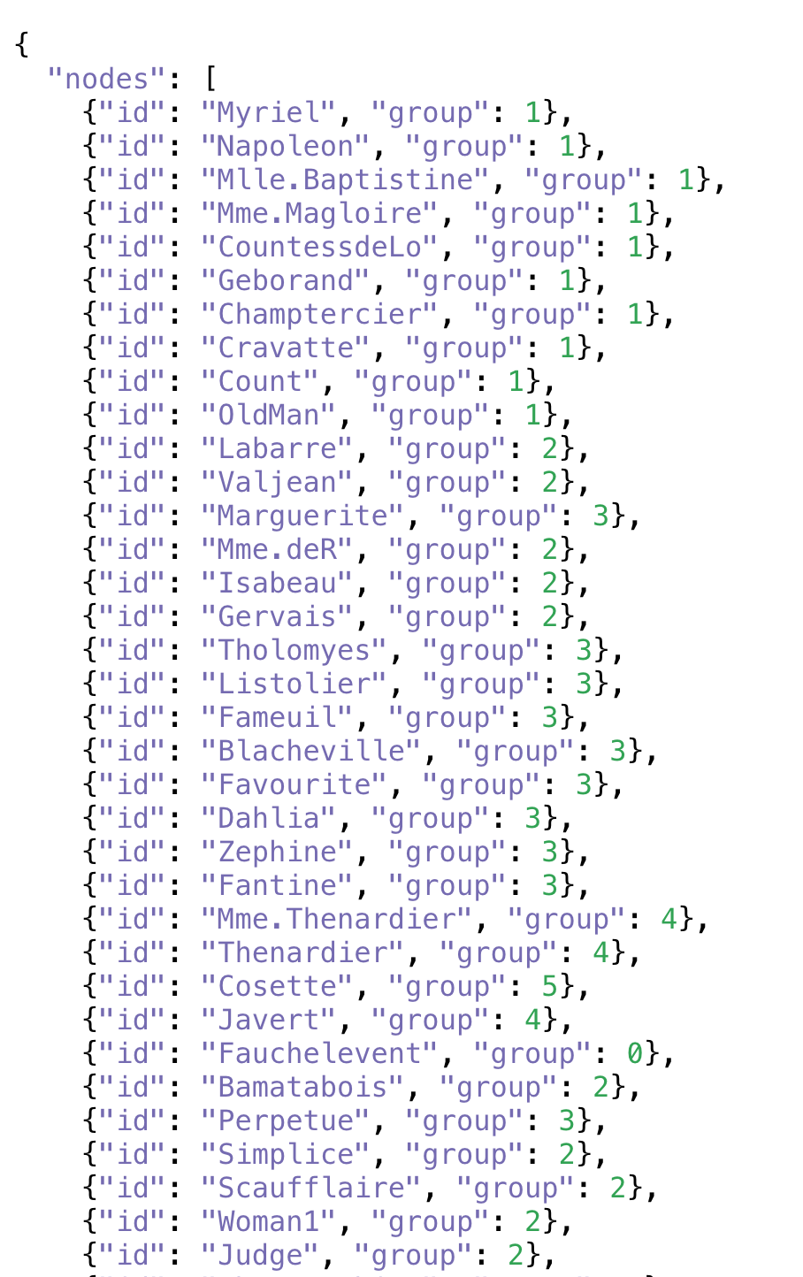
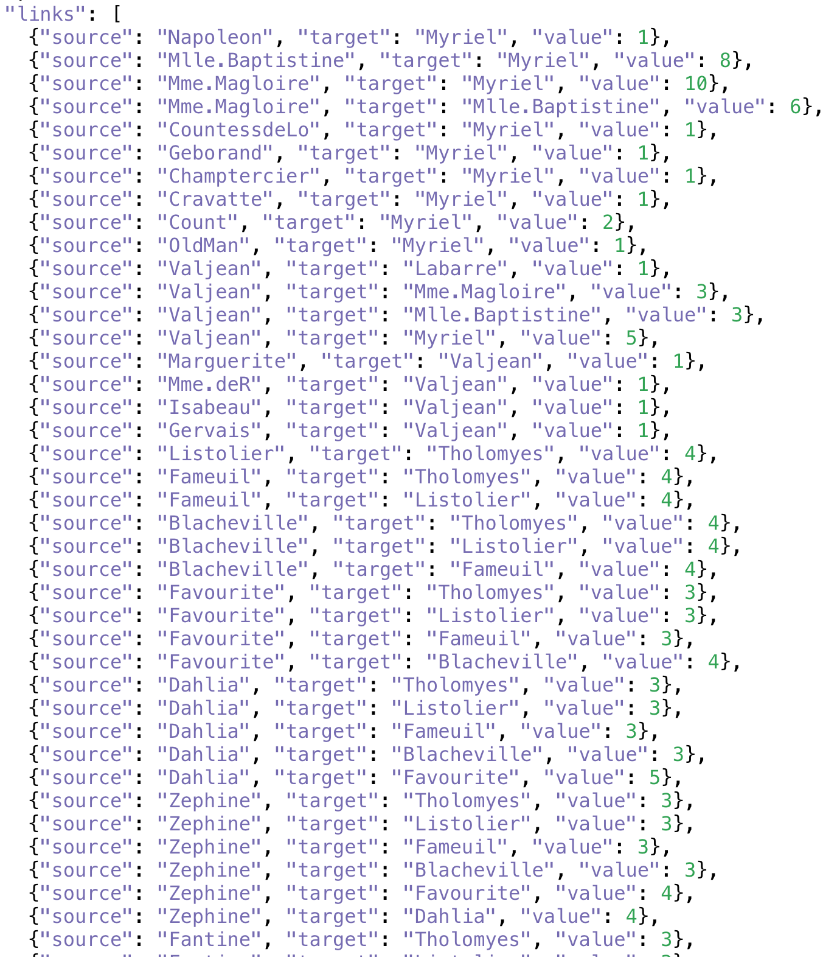
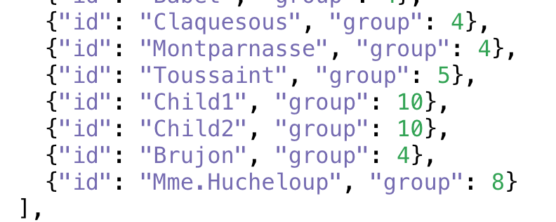
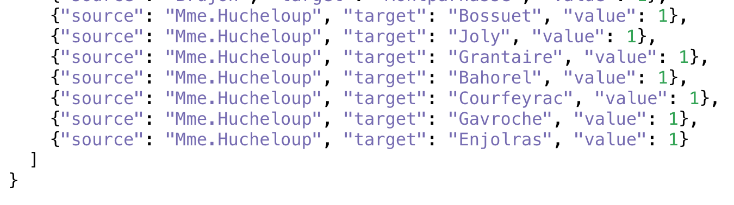
Data prepared by Mike Bostock
Notes:
Let’s say you have this data. Now how do you visualize this data? Simply. Okay, so you have nodes and links, so may be with a graph. Fine. But, how do you bring out inherent structure in the data, let’s say inherent clusters or relationships between these nodes. You might not have time for complex graph algorithms, you need not implement a clustering algorithm on top of it. All you need to know is two simple laws from high school physics. And you get this… (next slide)
Data: Les Miserables, Character Co-occurrences (Network)
Adapted by: Mike Bostock (creator of D3)

Slide 3
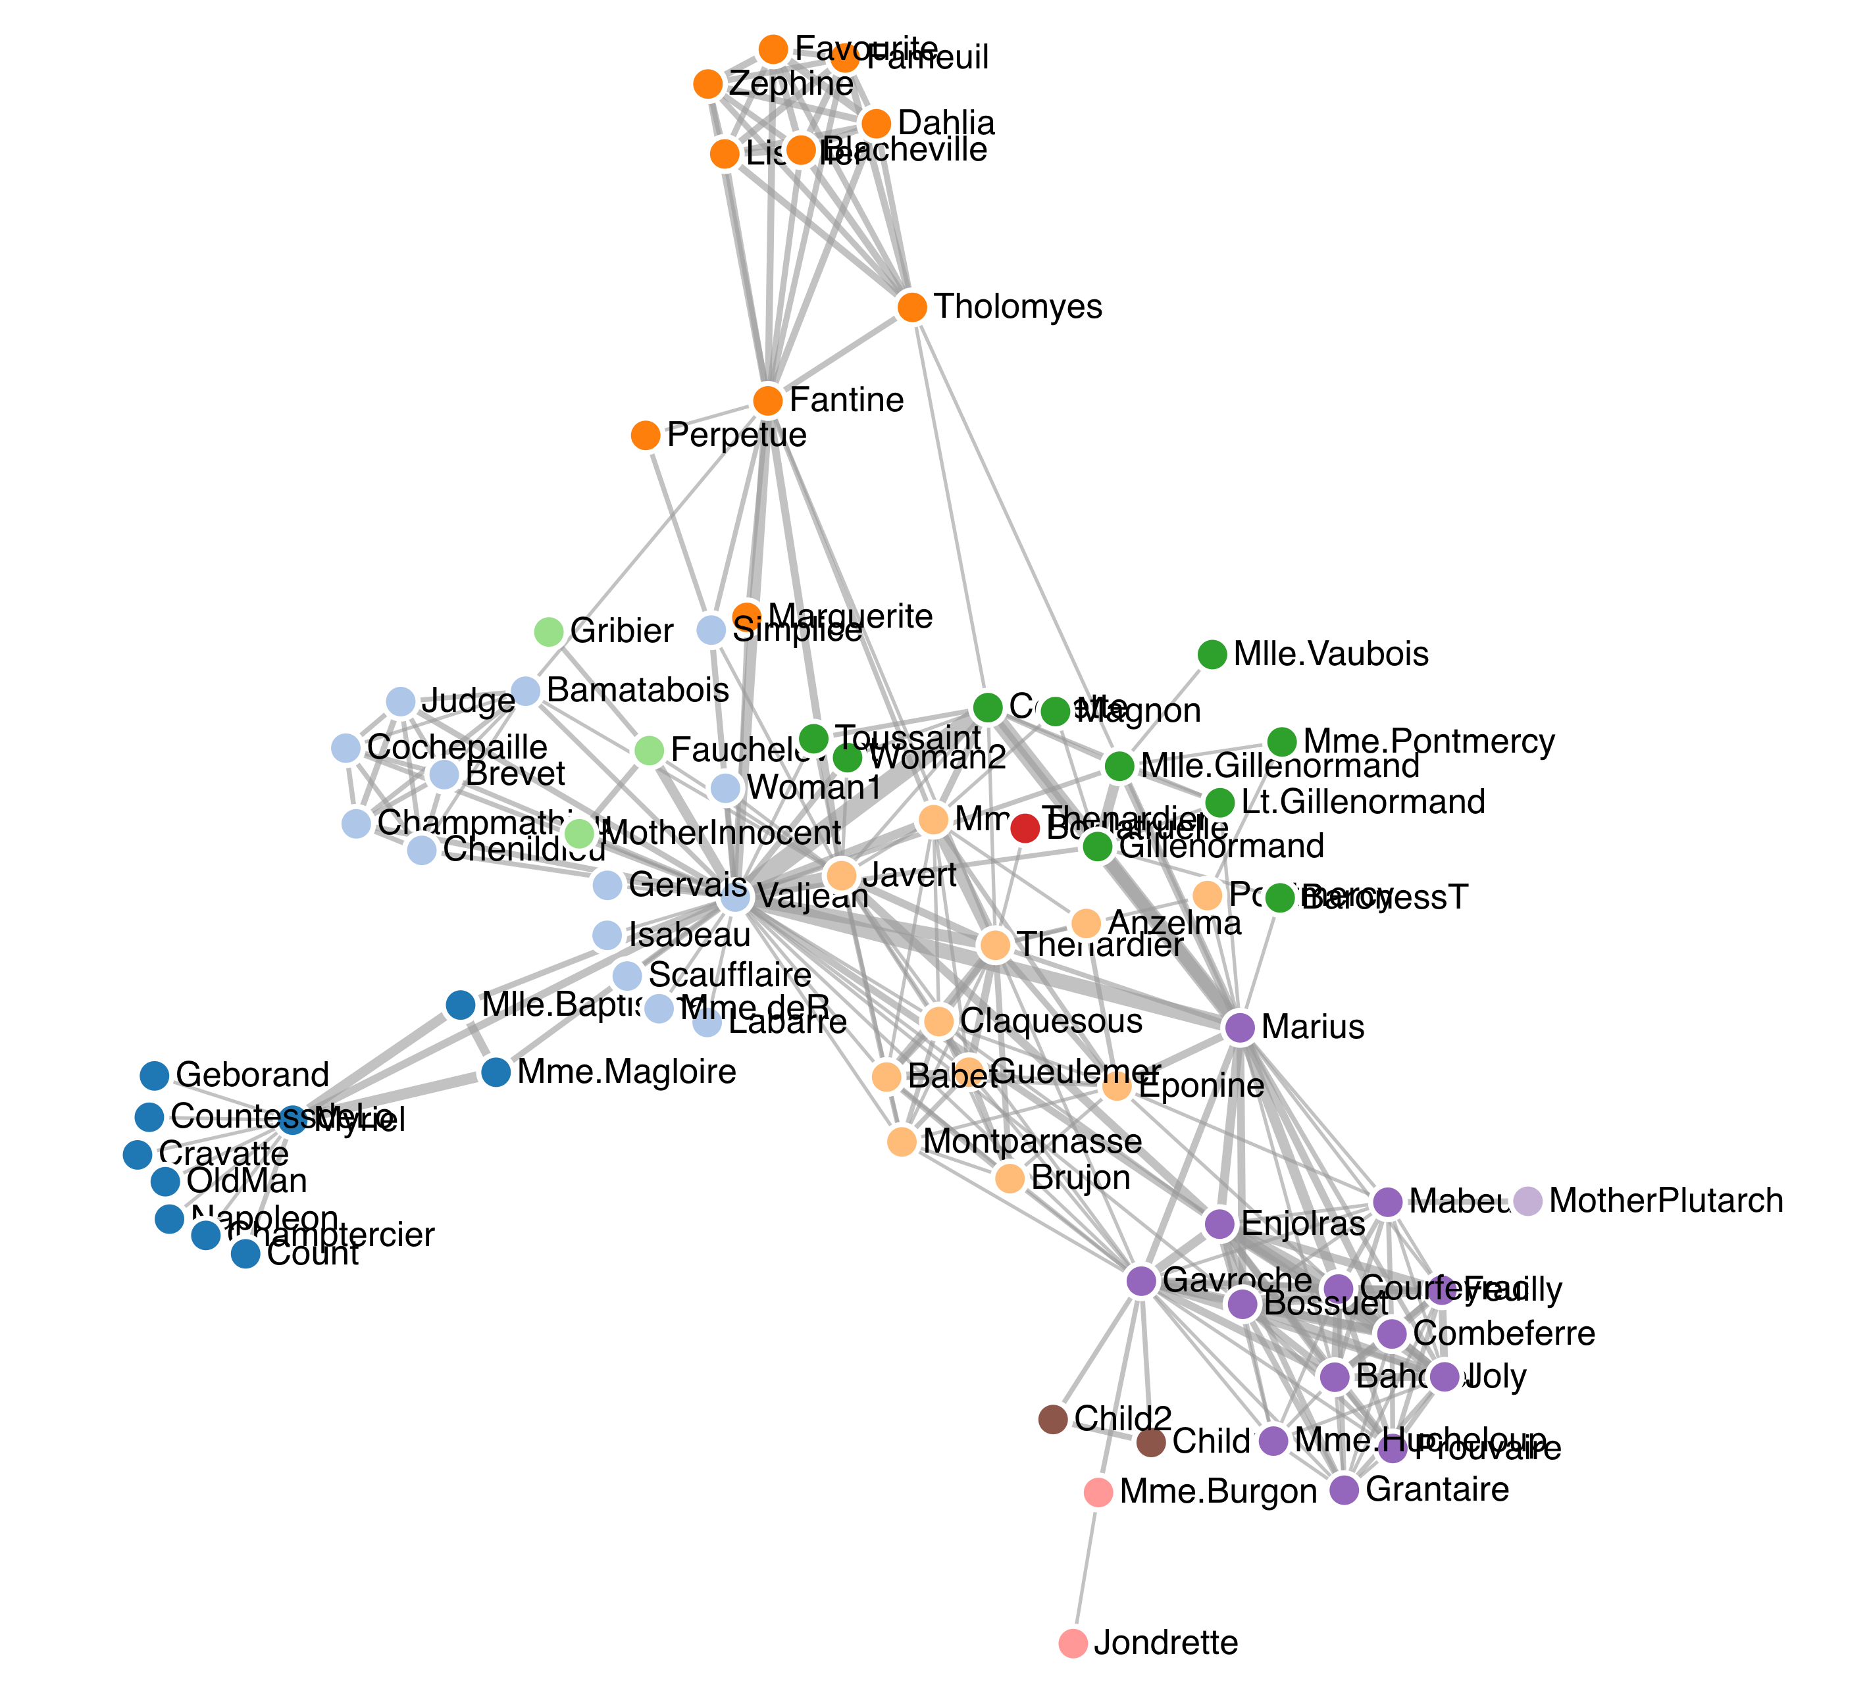
Force-Directed Graph
Layout
https://bl.ocks.org/heybignick/3faf257bbbbc7743bb72310d03b86ee8
Notes:
Force-directed layouts are quite good at uncovering inherent structures in graphs.

Slide 4
HOOKE’S LAW
F_{spring} = - k Δx
https://phet.colorado.edu/sims/html/hookes-law/latest/hookes-law_en.html

Slide 5
COULOMB’S LAW
https://scratch.mit.edu/projects/36680348/

Slide 6
Repulsive Force between Nodes
Coulomb’s Law
Attractive Force in Links
Hooke’s Law

Slide 7
Node 1
Node 2
Spring Force
Electrical Force

Slide 8
Fruchterman-Reingold
Every node repels other nodes
Connected nodes attract
(edge compression)
1| Compute all forces on each node
Additional gravitational force
towards the centre¹
¹ To ensure a spherical layout and prevent 0 degree vertices from straying too far

Slide 9
2| Compute the resultant force on each node

Slide 10
3| Compute new node positions

Slide 11
4| Iterate until equilibrium/steady state

Slide 12
Minimum Energy State / Steady State

Slide 13
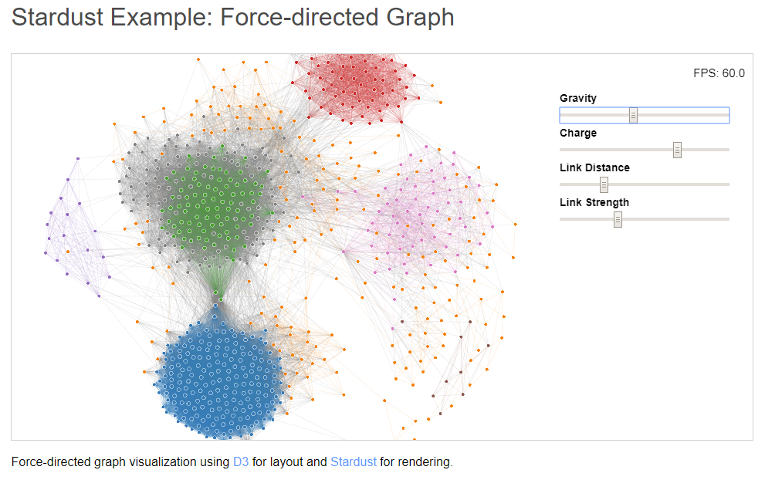
DEMO
https://stardustjs.github.io/examples/graph/

Slide 14
Advantages | Disadvantages
Simplicity in understanding and execution | High running time time complexity O(n³)
Flexibility easily extended | Local minima trap graph not guaranteed to reach global minimum
Clarity optimizes to reduce edge crossings and node overlaps | Visual clumping for high number of nodes
Interactivity preferred choice for dynamic and online graph-drawing systems | Non-deterministic may not get the same layout for different runs
Notes:
Simplicity – good choice when just want to draw a general graph, and do not have specific domain knowledge about the topology e.g. hierarchical
Flexibility – they are versatile in the sense that a lot of customization can be done to the aesthetic e.g directed graphs, 3D graph drawing, dynamic graphs – hence one if not the most common layout for node-link diagrams
Clarity - layout algorithm places the more interconnected nodes together, the cluster patterns implicitly emerge – however artefacts may appear as well because of repulsion from elsewhere
Interactivity – like the D3 example previously
High running time - n is the number of nodes of the input graph. This is because the number of iterations is estimated to be O(n), and in every iteration, all pairs of nodes need to be visited and their mutual repulsive forces computed. Approximations exist e.g Barnes–Hut n*log(n) complexity, consider only neighboring vertices
Local minima – may be much poorer than global leading to poor drawings
Visual clumping – 500-1000 nodes and below

Slide 15
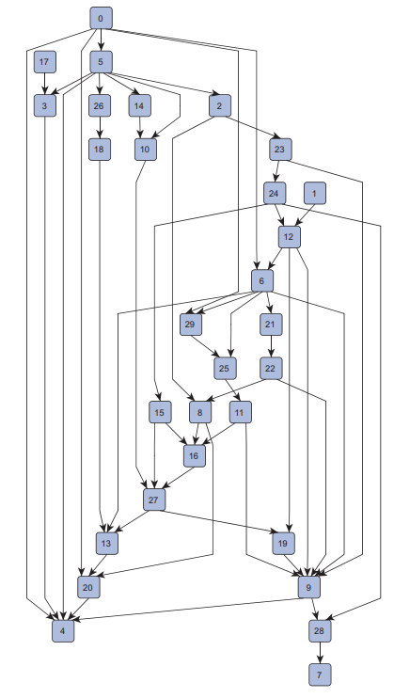
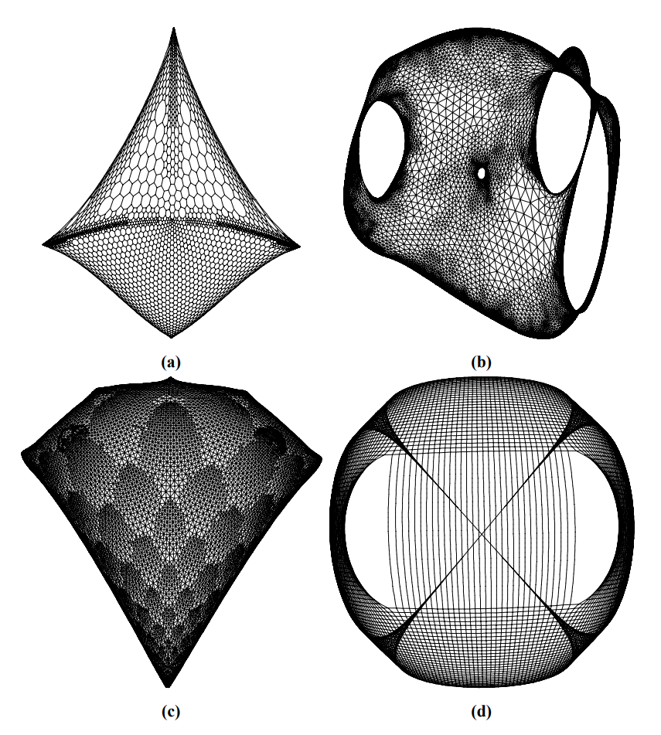
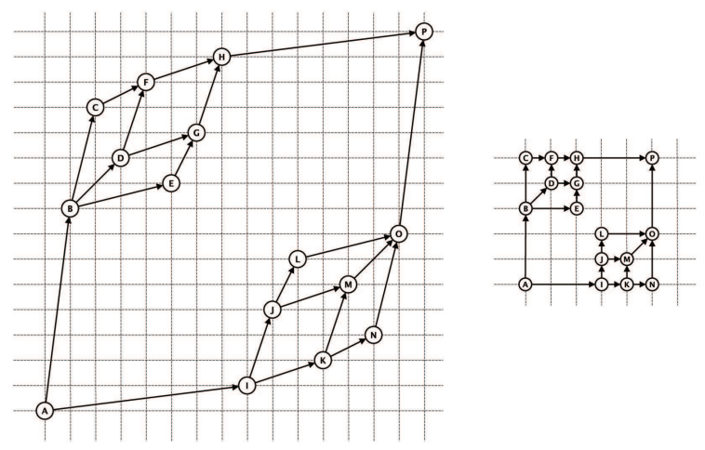
ALTERNATIVES
Koren, Yehuda (2005), "Drawing graphs by eigenvectors: theory and practice" (PDF), Computers & Mathematics with Applications, 49 (11–12): 1867–1888
Eiglsperger, M., Siebenhaller, M., & Kaufmann, M. (2004, September). An efficient implementation of Sugiyama’s algorithm for layered graph drawing. In International Symposium on Graph Drawing (pp. 155-166). Springer, Berlin, Heidelberg.
Kornaropoulos, E. M. (2012). Dominance drawing of non-planar graphs (Doctoral dissertation, Masters Thesis, Department of Computer Science, University of Crete).
Spectral layout
Uses eigenvectors of related matrices
Can calculate optimal layout
Fast
Layered / Hierarchical layout
Directed graph with edges generally drawn downwards
Can provide initial placement for force directed algorithms
Dominance drawing
Vertices are placed such that cartesian coordinates are greater or equal to previous vertex

